Slide 1

By NC file output, we generate
some PP XML infos
By NC control start,
we generate kinematics, tooling
& origin infos
By NC control start,
we copy the NC file
../Nccontrol/Programdata/Nc2check
../Nccontrol/Programdata/Nc2check
Camparser.NCC
Camparser.XML
NC2check
Camparser.NC
../Nccontrol/Programdata/Nc2check/machines/xxx
xxx.PAR
xxx.RED
Camparser.SIM

Slide 2


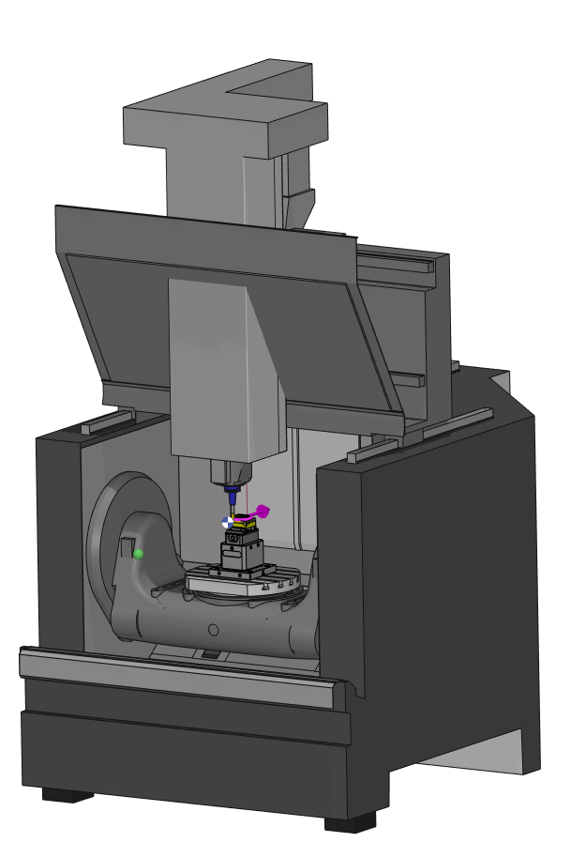
../NCcontrol/ProgramData/NC2check
../NCcontrol/ProgramData/NC2check/machines/mac1
Input
4
3
mac1.PAR
1
Camparser.NCC
mac1.RED
3
Camparser.XML
NC2check
Configuration machine
2
4
Camparser.NC*
5
* Copy of the original NC file
5
../NCcontrol/ProgramData/NC2check/machines/mac1/tnc
../NCcontrol/ProgramData/Tool4Tools/resources
SOF (start of File)
2
Machines.XML
3
5
EOF (end of File)
TOOLCHANGE
../NCcontrol/ProgramData/NC2check
Mxx1
Mxx2
Camparser.SIM
6
Mxx…
Output
Macros machine

